Slide 1




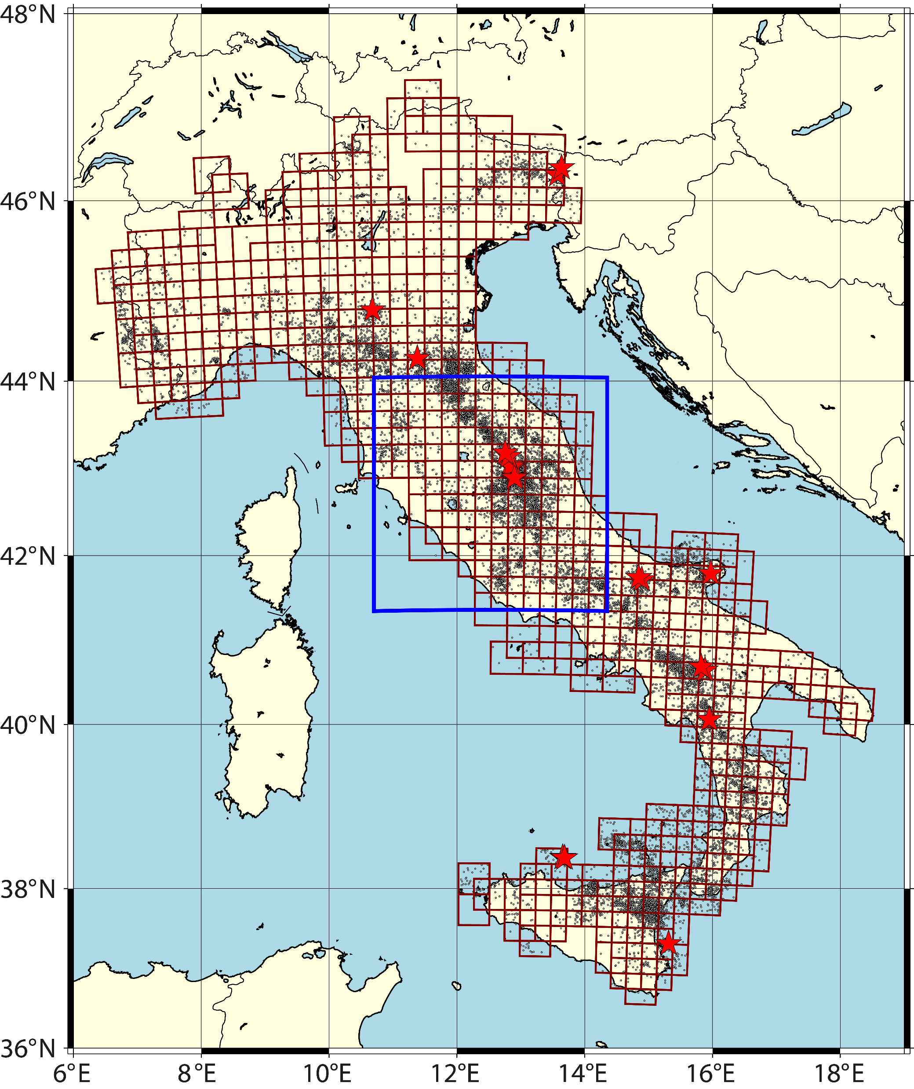
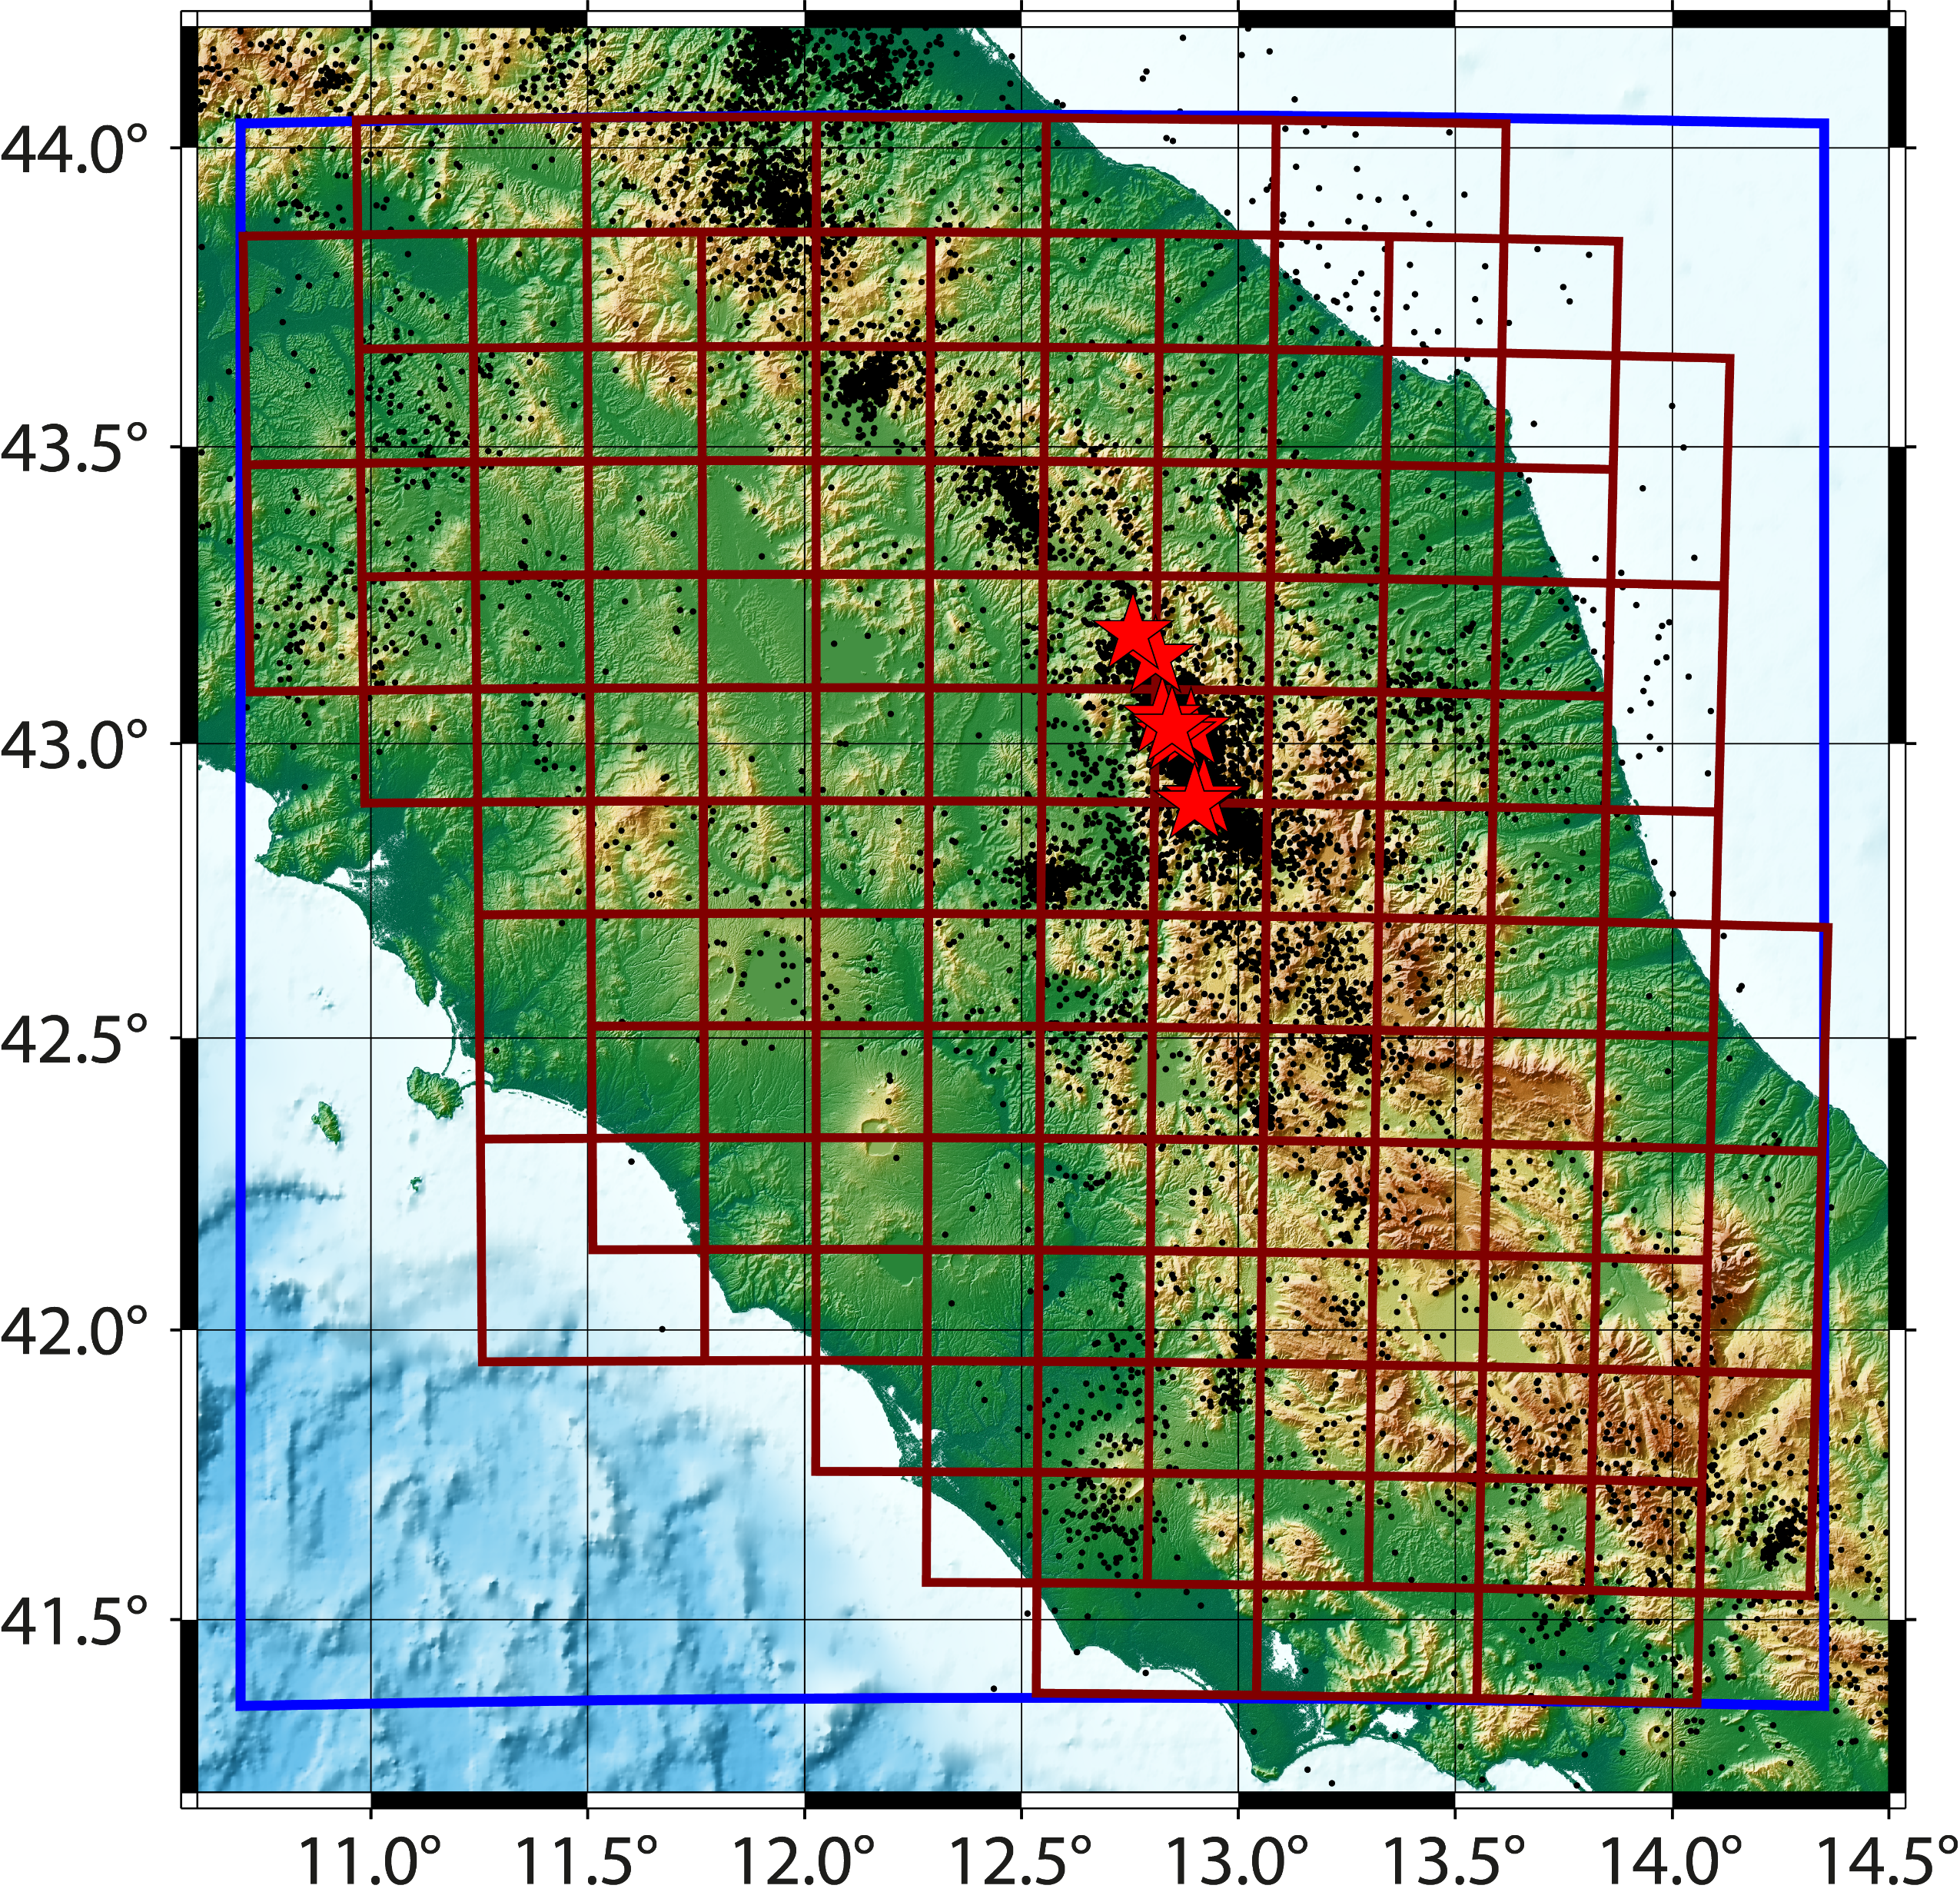
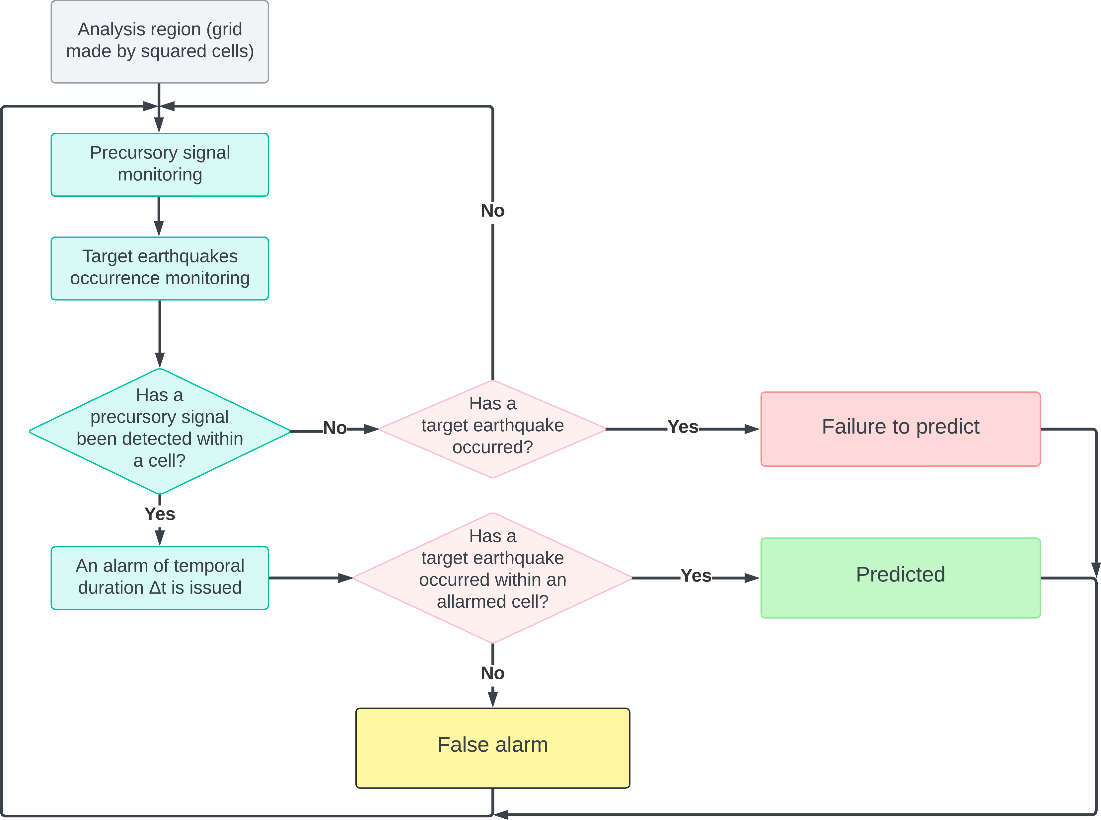

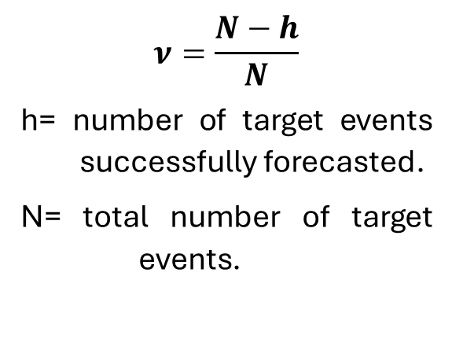
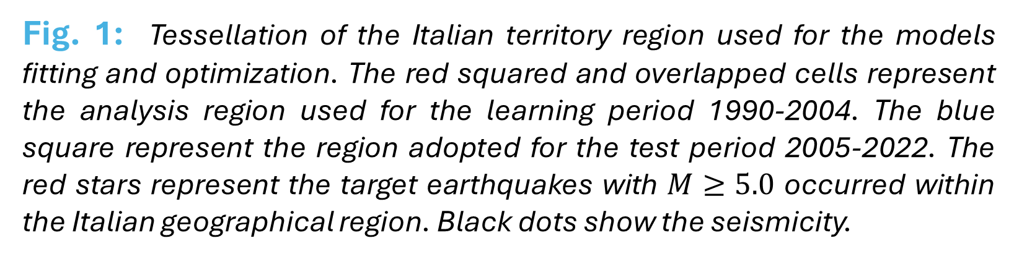

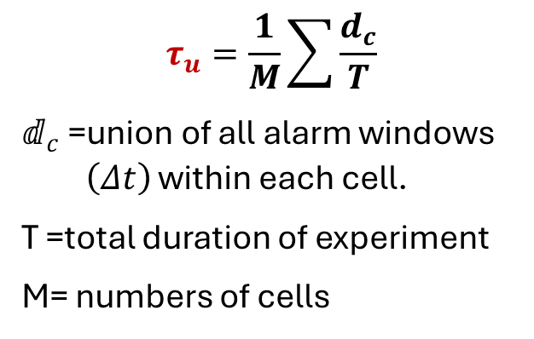
Pseudo-prospective earthquakes forecasting experiment in Italy based on temporal variation of the b-value of the Gutenberg-Richter law.
E. Biondini¹, F. D’Orazio¹, B. Lolli^{2,1} and P. Gasperini^{1,2}
EGU24-13405 Hall X4 NH4.3
¹Dipartimento di Fisica e Astronomia, Università di Bologna, Bologna, I-40127, Italy. E-mail: emanuele.biondini2@unibo.it; flavia.dorazio@studio.unibo.it; paolo.gasperini@unibo.it
.
²Istituto Nazionale di Geofisica e Vulcanologia, Sezione di Bologna, Italy. E-mail: barbara.lolli@ingv.it
Vienna, Austria & Online | 14–19 April 2024
1- Abstract
The analysis of spatio-temporal variations of the b-value of the frequency-magnitude distribution (Gutenberg and Richter, 1944) of earthquake occurrence can be considered an important indicator for understanding the processes preceding strong seismic events. Indeed, this parameter is inversely correlated to the accumulation of differential stress in crustal rocks (Scholz, 1968).
Variations in the b-value can therefore provide valuable information about the state of stress and the probability of earthquakes occurring in a specific geographic region. Such spatio-temporal variations can then be analyzed as a precursor signal of strong seismic events. In fact, in many cases, the b-value tends to decrease in the preparatory stages of a strong earthquake, and then suddenly increase after the main shock has occurred (Gulia et al., 2018).
To evaluate this hypothesis, an alarm-based forecasting method using spatio-temporal variations of the b-value as a precursor signal (b-model) is implemented in this work.
The forecasting capabilities were assessed using tests and statistics specific to alarm-based models. These capabilities were then compared with those of the FORE model (Gasperini et al., 2021), which uses the occurrence of potential strong foreshocks as a precursor signal, and with those of an ETAS-SVP model (Biondini et al., 2023), both applied using an alarm-based approach.
Moreover, we explored both the union (United model) and intersection (Inter model) of the b-value and FORE models to analyze the combined forecasting performance.
4– Optimization of alarm thresholds (Learning period)
The alarm threshold for the precursor signal of each model was chosen through an optimization procedure conducted during the learning period (1990-2004) by testing different thresholds.
To choose the optimal precursors thresholds (Fig. 2) we used the maximum Area Skill score (AS).
Fig. 2: For each model is represented the Area Skill (AS) score computed for targets with Mw≥5.0, using unweighted (red) and weighted (dark blue) fractions of space-time occupied by alarms. The bars represent the fractions of space-time occupied by alarms considering Δt=1 year as alarm time.
b-value model
Fore model
ETAS model
2- Setting up the forecasting experiment
All models are fitted to forecast earthquakes with magnitude Mw≥5.0 in the Italian geographical region, over a spatial grid of 337 overlapped squared cells of side L=30√2 km shown in Fig. 1.
The optimization of the different precursor signals (see Table 1) has been conducted for the period 1990-2004.
The used dataset is the Homogenized instRUmental Seismic (HORUS) catalog (Lolli et al. 2020) from 1960 to 2022 (downloadable from http://horus.bo.ingv.it).
5– Pseudo-prospective test for the Central Italy region
Using the calibrated models, we assessed their pseudo-prospective performance for the Central Italy region indicated by the blue square in Fig. 1 and showed in detail in the Fig. 3, for the period 2005-2022.
To assess the forecasting performance of alarm-based models we adopted the Molchan’s diagram (Molchan, 1990, 1991).
Molchan's test compare the forecasting performance obtained by a forecasting method (blue and red trajectories in the diagrams) with that obtained by a purely random model that simply forecast earthquakes in proportion to the fraction of space-time occupied by the alarms (diagonal line of the diagram).
According to this test, the closer the Molchan trajectory is to the lower left-hand corner of the diagram, the higher the performance of the model (Fig. 4).
Table 1: Summary of tested forecasting models.
b-value model
Fore model
United model
Inter model
ETAS model
Model | Precursor | Reference
b-model | Decrease of the b-value below a certain threshold value. | Biondini et al., (in preparation)
FORE | Occurrence of a strong potential foreshock. | Gasperini et al., (2021)
United model | Decrease of b-value or occurrence of a potential foreshock. | Biondini et al., (in preparation)
Inter model | Decrease of b-value concurrently with an occurrence of a potential foreshock. | Biondini et al., (in preparation)
ETAS-SVP | Exceeding the expected rate of an established threshold. | Biondini et al., (2023)
Fig. 1: Tessellation of the Italian territory region used for the models fitting and optimization. The red squared and overlapped cells represent the analysis region used for the learning period 1990-2004. The blue square represent the region adopted for the test period 2005-2022. The red stars represent the target earthquakes with $M≥5.0$ occurred within the Italian geographical region. Black dots show the seismicity.
Target earthquake ≥ 5.0
3- Alarm-based approach
The alarm-based approach in earthquake forecasting is based on the detection of precursor phenomena that could indicate an impending earthquake. When one of these signals is detected, an alarm is triggered for that area. If in an alarmed area a target earthquake occurs it is considered as “predicted”.
b-value model
Fore model
United model
Inter model
ETAS model
Target earthquake ≥ 5.5
Following Molchan (1990, 1991), the forecasting experiment is repeated many times using wider alarm durations 𝛥𝑡. For each 𝛥𝑡 we estimate:
Miss rate
Fraction of space-time occupied by alarms
Weighted fraction of space-time occupied by alarms
Fig. 4: Molchan diagrams and AS score of the tested models. Red and dark blue lines indicate the forecasting performance of expected daily rate threshold for unweighted ($τ_{u}$) and weighted ($τ_{w}$) fractions of space-time occupied by alarms respectively. The black continuous line indicates a purely random forecasting method that separates skilled (below the line) from unskilled (above) forecasting methods. The light blue, violet and green lines indicate the confidence limits for $α=50\%,$5%, and 1% respectively.
$$ν=\frac{N−h}{N}$$
h= number of target events successfully forecasted.
N= total number of target events.
$$τ_{u}=\frac{1}{M}\sum{\frac{d_{c}}{T}}$$
$ⅆ_{c}$ =union of all alarm windows $\left(Δt\right)$ within each cell.
T =total duration of experiment
M= numbers of cells
$$τ_{w}=\frac{\sum{λ_{aνe}}τ_{c}}{\sum{λ_{ave}}}$$
For more information see Gasperini et al. (2021)
Following Shebalin et al. (2011), the miss rates ($ν$) of the analyzed models can also be compared to another skilled reference model, characterized by its space-time fractions occupied by alarms ($τ_{ref}$) and miss rates ($ν_{ref}$).
The miss rates ${(ν}_{ref})$ of the reference model are plotted on the diagonal line of the Molchan diagram were $τ=1−ν_{ref}$.
A linear interpolation is needed to plot the expected miss rates ($ν$) of other models against $τ=1−ν_{ref}$, as they are computed at different values of $τ$ compared to the reference model's $τ_{ref}$.
Such parameters are necessary to draw Molchan’s diagrams (see as example Fig. 4) and to assess the (AS) Area skill score (Zechar and Jordan 2008, 2010).
Area Skill score: Normalized area upper the Molchan’s trajectory.
Target earthquake ≥ 5.0
Target earthquake ≥ 5.5
Fig. 3: Same as Fig. 1 but showing details for the Central Italy region used as test area for the pseudo-prospective forecasting experiment.
Fig. 5: Molchan diagram and AS score of the analyzed models considering the ETAS-SVP model as reference and The diagonal continuous line (orange) indicates the miss rates of the ETAS-SVP model and separates models with higher performance (below the line) from with those with lower performance (above).
Forecasted
Missed
False alarm
References
Biondini, E., D. A. Rhoades, and P. Gasperini (2023). Application of the EEPAS earthquake forecasting model to Italy, Geophysical Journal International, ggad123, doi: 10.1093/gji/ggad123.
Gasperini, P., E. Biondini, B. Lolli, A. Petruccelli, and G. Vannucci (2021). Retrospective short-term forecasting experiment in Italy based on the occurrence of strong (fore) shocks, Geophysical Journal International 225, no. 2, 1192–1206, doi: 10.1093/gji/ggaa592.
Gulia, L., A. P. Rinaldi, T. Tormann, G. Vannucci, B. Enescu, and S. Wiemer (2018). The Effect of a Mainshock on the Size Distribution of the Aftershocks, Geophysical Research Letters 45, no. 24, doi: 10.1029/2018GL080619.
Gutenberg, B., and C. F. Richter (1944). Frequency of earthquakes in California*, Bulletin of the Seismological Society of America 34, no. 4, 185–188, doi: 10.1785/BSSA0340040185.
Molchan, G. M. (1990). Strategies in strong earthquake prediction, Physics of the Earth and Planetary Interiors 61, no. 1, 84–98, doi: 10.1016/0031-9201(90)90097-H.
Molchan, G. M. (1991). Structure of optimal strategies in earthquake prediction, Tectonophysics 193, no. 4, 267–276, doi: 10.1016/0040-1951(91)90336-Q.
Rovida, A., M. Locati, R. Camassi, B. Lolli, P. Gasperini, and A. Antonucci (2022). Parametric Catalogue of Italian Earthquakes (CPTI15), version 4.0, Istituto Nazionale di Geofisica e Vulcanologia (INGV), doi: 10.13127/CPTI/CPTI15.4.
Shebalin, P., C. Narteau, M. Holschneider, and D. Schorlemmer (2011). Short-Term Earthquake Forecasting Using Early Aftershock Statistics, Bulletin of the Seismological Society of America 101, no. 1, 297–312, doi: 10.1785/0120100119.
Scholz, C. H. (1968). The frequency-magnitude relation of microfracturing in rock and its relation to earthquakes, Bulletin of the Seismological Society of America 58, no. 1, 399–415, doi: 10.1785/BSSA0580010399.
Zechar, J. D., and T. H. Jordan (2008). Testing alarm-based earthquake predictions, Geophysical Journal International 172, no. 2, 715–724, doi: 10.1111/j.1365-246X.2007.03676.x.
Zechar, J. D., and T. H. Jordan (2010). The Area Skill Score Statistic for Evaluating Earthquake Predictability Experiments, Pure Appl. Geophys. 167, no. 8–9, 893–906, doi: 10.1007/s00024-010-0086-0.

